Slide 1

2021/22
New Managers meeting
Wednesday 21st July 2021
8pm

Slide 2

2021/22
New Managers meeting
YEL Updates
General and social media
Scoreline admin system
WGS & Player Registrations
FA Full-Time
YELonline.com
Rules & Regulations & Deadlines
Referees
Fixtures & scheduling
Cup competitions & Festivals
Presentation Days
Admin

Slide 3


2021/22
New Managers meeting
YEL Updates
Sent out regularly
Important admin information for club officials to deal with
Information to be shared with team managers/admins
Updates are then posted in the news section of YELonline.com for reference
Admin

Slide 4


2021/22
New Managers meeting
General &
social media
ALWAYS include club/team name, age group and day in emails to office
Busy times – 48hr response – don’t email again – unnecessarily blocks inbox
Club Officials and Team managers - join the YEL Facebook (YEL East Midlands) & Twitter (@YELNottm) – easiest way to get info out quickly
Admin

Slide 5

2021/22
New Managers meeting
Scoreline system
All club officials must sign in – YEL reg 1!
Club & teams contacts
Contact the YEL Office – similar to WhatsApp
Finance – all invoices listed
Venues listed
YEL On The Go app
Must be kept up to date alongside WGS
How to guide if struggling with anything
Admin

Slide 6


2021/22
New Managers meeting
WGS & Player reg
All players are registered on WGS
No player is permitted to play unless registered and approved by the league
Pre match ID checks are a mandatory part of the YEL rules
WGS must be kept up to date – manager and coach changes – emails, mobile nos. etc – info transfers through to Full-Time
Admin

Slide 7

2021/22
New Managers meeting
FA Full-Time
All fixtures are set and sent out via Full-Time
Refs appointed for U9s to U14s
Primary contact per team – respond to verification emails – time restricted
SMS text contact
Match returns – MUST be completed by U9s –U14s. Biggest avoidable fine - £5, £10, £20
Don’t trust MatchDay app – CHECK!
Admin

Slide 8
2021/22
New Managers meeting
YELonline.com
Reference section for most things! Rules & Regs, Respect and Referees
Section for managers and coaches – recommended read – guide to ‘Day to day running of a YEL team’
YEL Community - £5,000 a year – league supporting our members projects
YEL Advance – two centres at the moment – provides UEFA coaching for YEL players regardless of ability
Admin

Slide 9
2021/22
New Managers meeting
Rules, Regs & Deadlines!
Rules & Regs are on YELonline.com & YEL On The Go
Rules need to be enforced as league is huge - perfectly manageable provided everyone on same page!
Deadlines on Facebook, Twitter and Updates – 31st July – Players, Free W/D, Invoices settled
If emailed by the league, please respond ASAP! – remember club name, team, age group & playing day
Admin

Slide 10
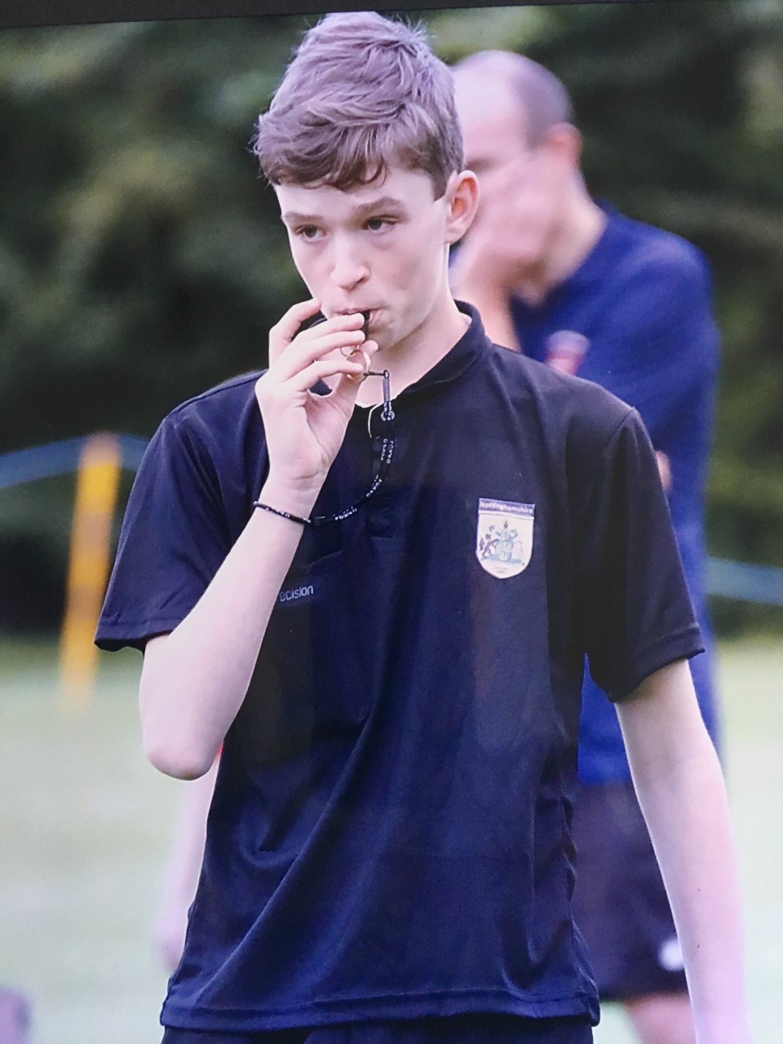
2021/22
New Managers meeting
Referees
Try to appoint to all U9 to U14 games –400+ games - massive shortage with all leagues
Sarah Smith is YEL Referees appointments. referees@yelonline.com for ref enquiries
Any team with own qualified ref that they want to use – email Sarah BEFORE appts are made (10 days) – ref schedule of when doing your games would be helpful
Appoint ten days in advance – make sure KO times are right and grounds correct on Full-Time
Contact ref as soon as you get the email
Appoint until Wednesday – ‘TBC’ and ‘none’
Admin

Slide 11
2021/22
New Managers meeting
Fixtures, Formats & scheduling
Massive job – 11,000+ fixtures a season
Set on Full-Time – home and away – balanced as best as possible for each club
KO times – default: mini soccer 10am; 9v9/11v11 11am
Clubs/teams responsibility to update on Full-Time – essential part of admin
Fixtures and events

Slide 12
2021/22
New Managers meeting
Fixtures, Formats & scheduling (cont)
Two seasons – promotion and relegation
7s & 8s monitored closely – every 3/4 weeks
9s/10s/11s – friendlies and competitive
12s to 14s – two competitive seasons
Cancellations - Important to update Full-Time and YEL Office so can be rescheduled
Cancellations will be fined –(1st - no points deduction/award – see rules)
Fixtures and events

Slide 13
2021/22
New Managers meeting
Festivals, Presentation Days & Cup competitions
Festivals may be organised subject to COVID
Presentation Days – February and June – Champions and runners up – 2,000 players get to be honoured in style
Ability based cup competitions – run at the end of Winter season into Spring season – 50+ finals in May
Every player gets the chance to taste success/play in a final, regardless of ability
Fixtures and events

Slide 14
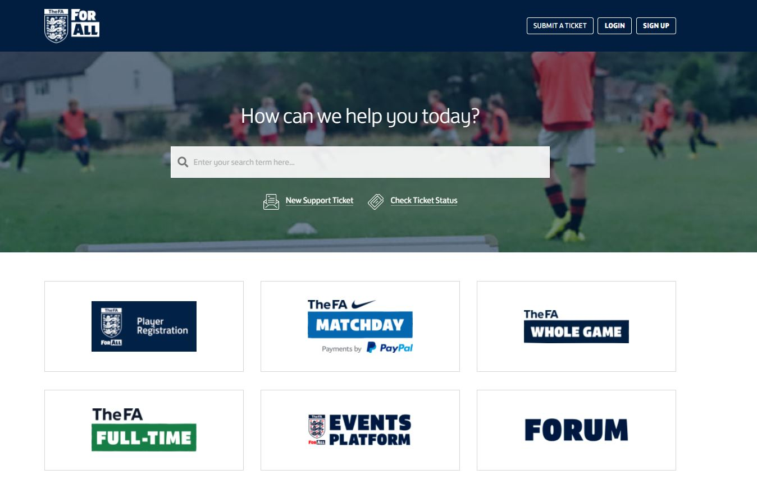
2021/22
New Managers meeting
….and finally
FA TECHNOLOGY – Online support to help answer a lot of questions re Full-Time, WGS, Player Reg, FA MatchDay app etc - https://grassrootstechnology.thefa.com/support/home
FULL-TIME – MATCH RETURN COMPLETION – how to input a match return video https://youtu.be/qI3kXiTj4WY
Admin

Slide 15
2021/22
New Managers meeting
….and finally….(cont)
SCORELINE LOG IN – If you have not had a log in (should have been sent when you were appointed as manager by club sec) email YEL Office – yel@live.co.uk
SCORELINE – Any questions log into Scoreline - https://yelscorelineportal.com/ check the videos on ‘Getting started’ top of left hand menu or email yel@live.co.uk
DAY TO DAY QUERIES – email yel@live.co.uk
Admin

